Slide 1
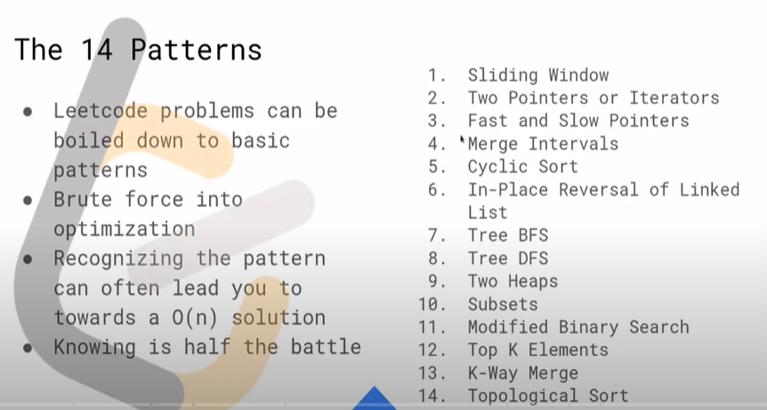
https://www.youtube.com/watch?v=g6TLB_tAaCI

Slide 2
https://www.youtube.com/channel/UC5UgemAz061hkjTFHOfxNpg
⌨️leetcod-patterns repo:
https://github.com/seanprashad/leetco...
⌨️leetcod-patterns list:
https://seanprashad.com/leetcode-patt...
👨🏽‍💻Maximum Average Subarray I:
https://leetcode.com/problems/maximum...
👨🏽‍💻Download Go: https://golang.org/
https://hackernoon.com/14-patterns-to-ace-any-coding-interview-question-c5bb3357f6ed
https://www.techinterviewhandbook.org/best-practice-questions
https://www.techinterviewhandbook.org/grind75
#Algorithmic Patterns for Coding Interviews: Intro
https://www.youtube.com/watch?v=cpgAULF6Vpw
https://seanprashad.com/leetcode-patterns/
https://edcode.xyz/
Leetcode 101: The 14 Patterns Introduction | Workshop (Winter 2022)
https://www.youtube.com/watch?v=g6TLB_tAaCI
https://www.techinterviewhandbook.org/best-practice-questions
Sean Prasad -https://leetcode.com/list/9k7j58mc/
https://leetcode.com/list/9k7sy4em/
https://www.techinterviewhandbook.org/software-engineering-interview-guide/
https://seanprashad.com/leetcode-patterns/
https://edcode.xyz/

Slide 3
TIPS -https://seanprashad.com/leetcode-patterns/
If input array is sorted then
- Binary search
- Two pointers
If asked for all permutations/subsets then
- Backtracking
If given a tree then
- DFS
- BFS
If given a graph then
- DFS
- BFS
If given a linked list then
- Two pointers
If recursion is banned then
- Stack
If must solve in-place then
- Swap corresponding values
- Store one or more different values in the same pointer
If asked for maximum/minimum subarray/subset/options then
- Dynamic programming
If asked for top/least K items then
- Heap
If asked for common strings then
- Map
- Trie
Else
- Map/Set for O(1) time & O(n) space
- Sort input for O(nlogn) time and O(1) space

Slide 4
Sliding Window

Slide 5
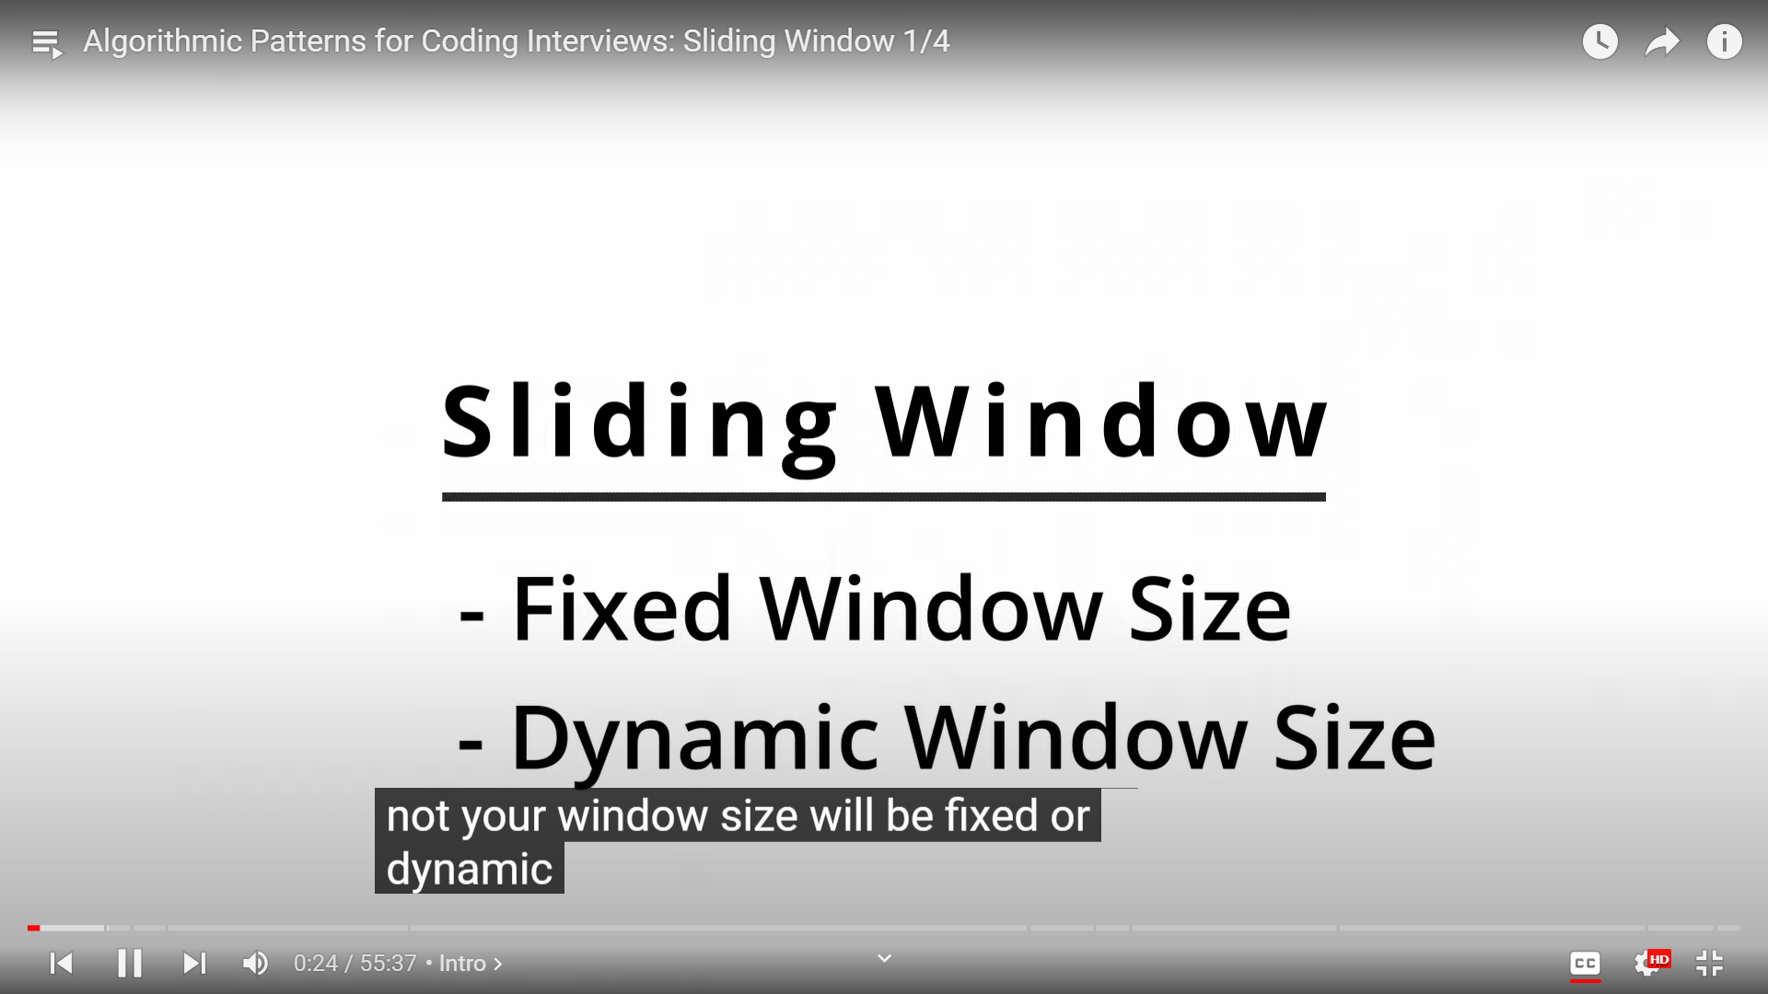

Slide 6
Fixed Sliding Window

Slide 7
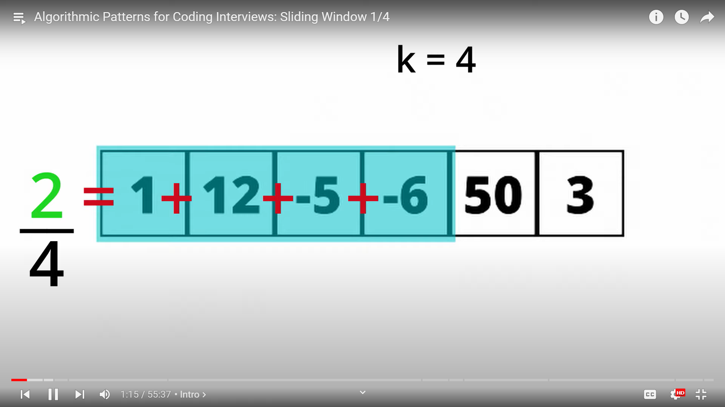

Slide 8
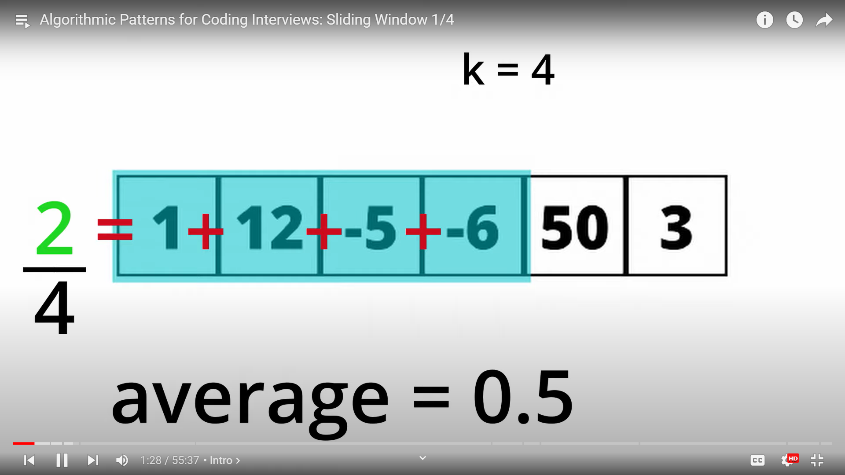

Slide 9
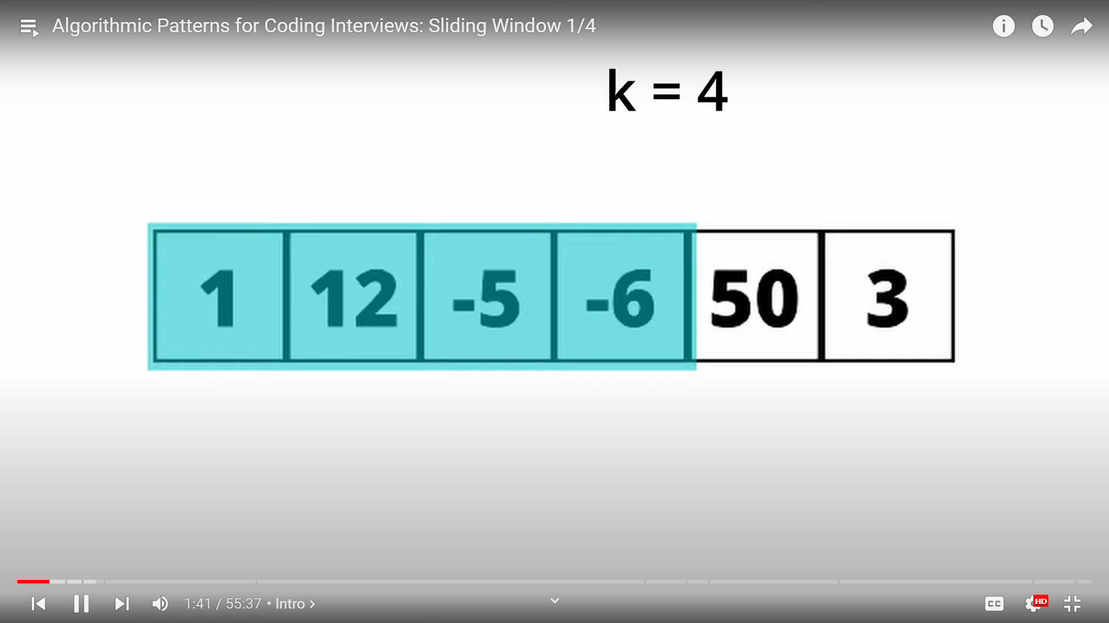

Slide 10
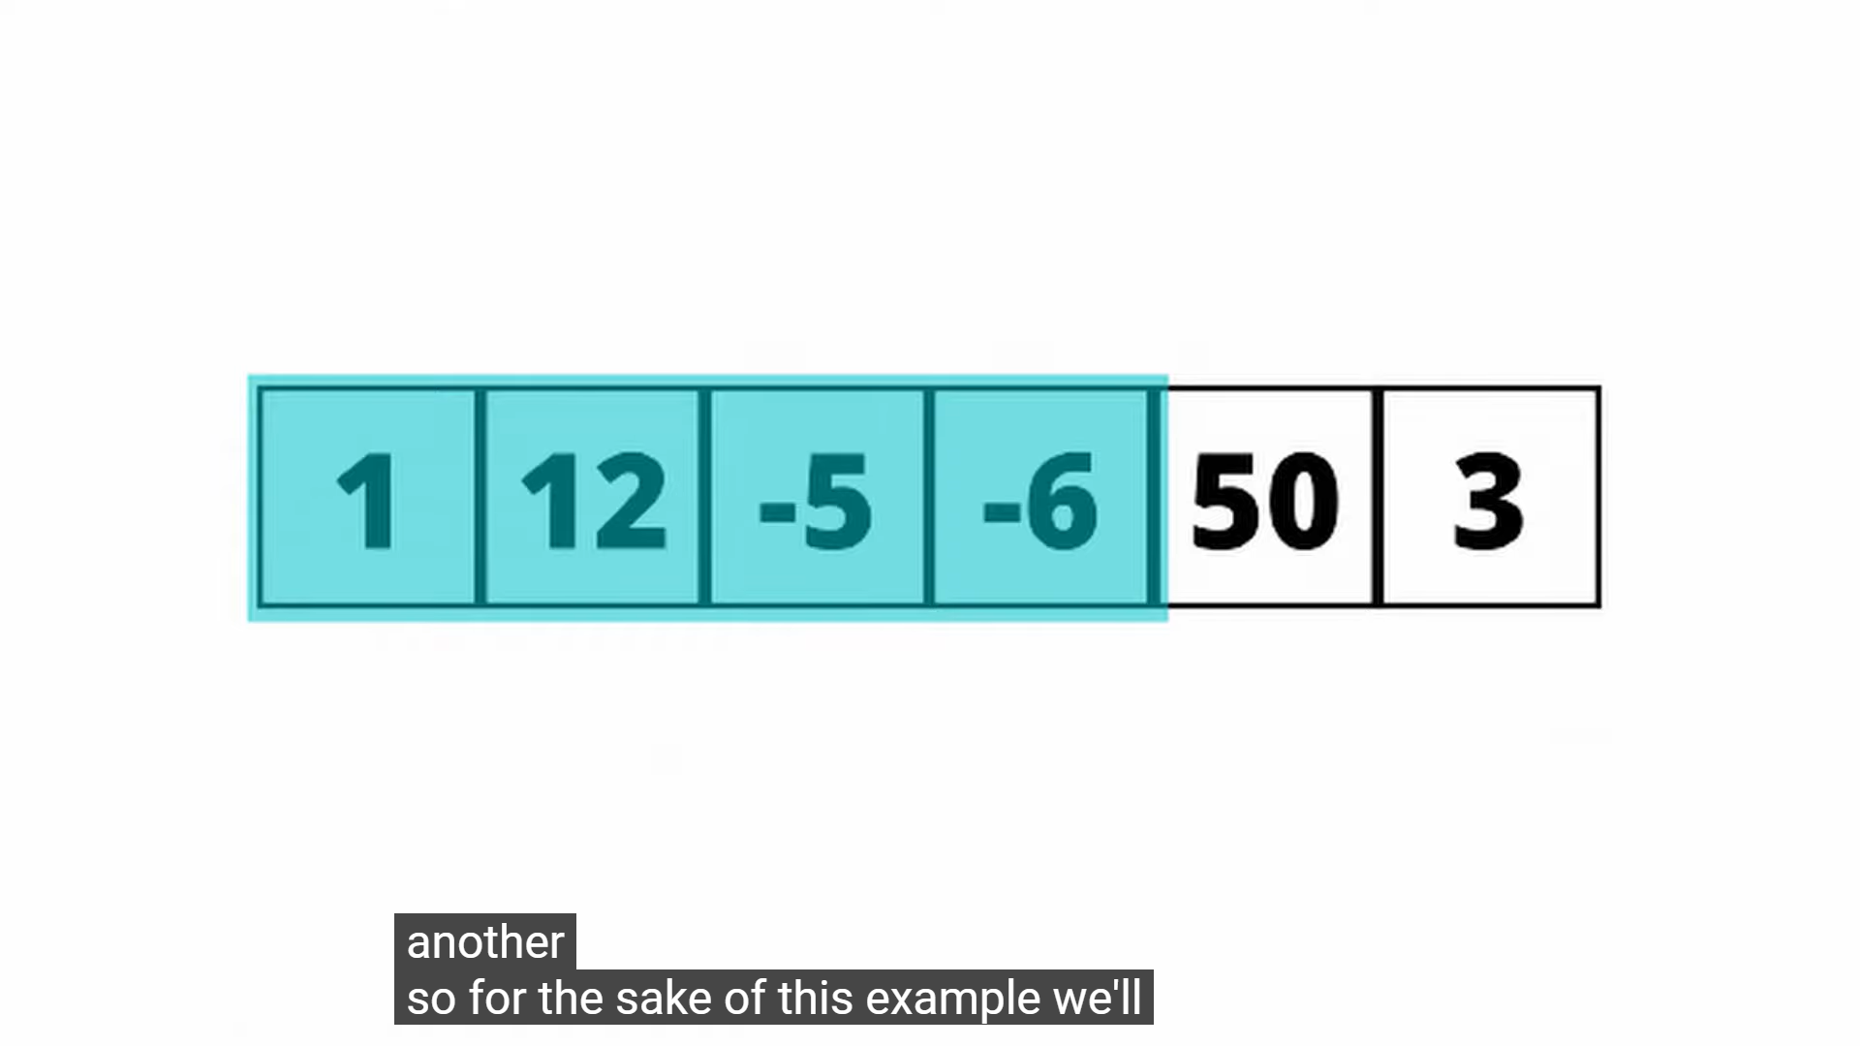
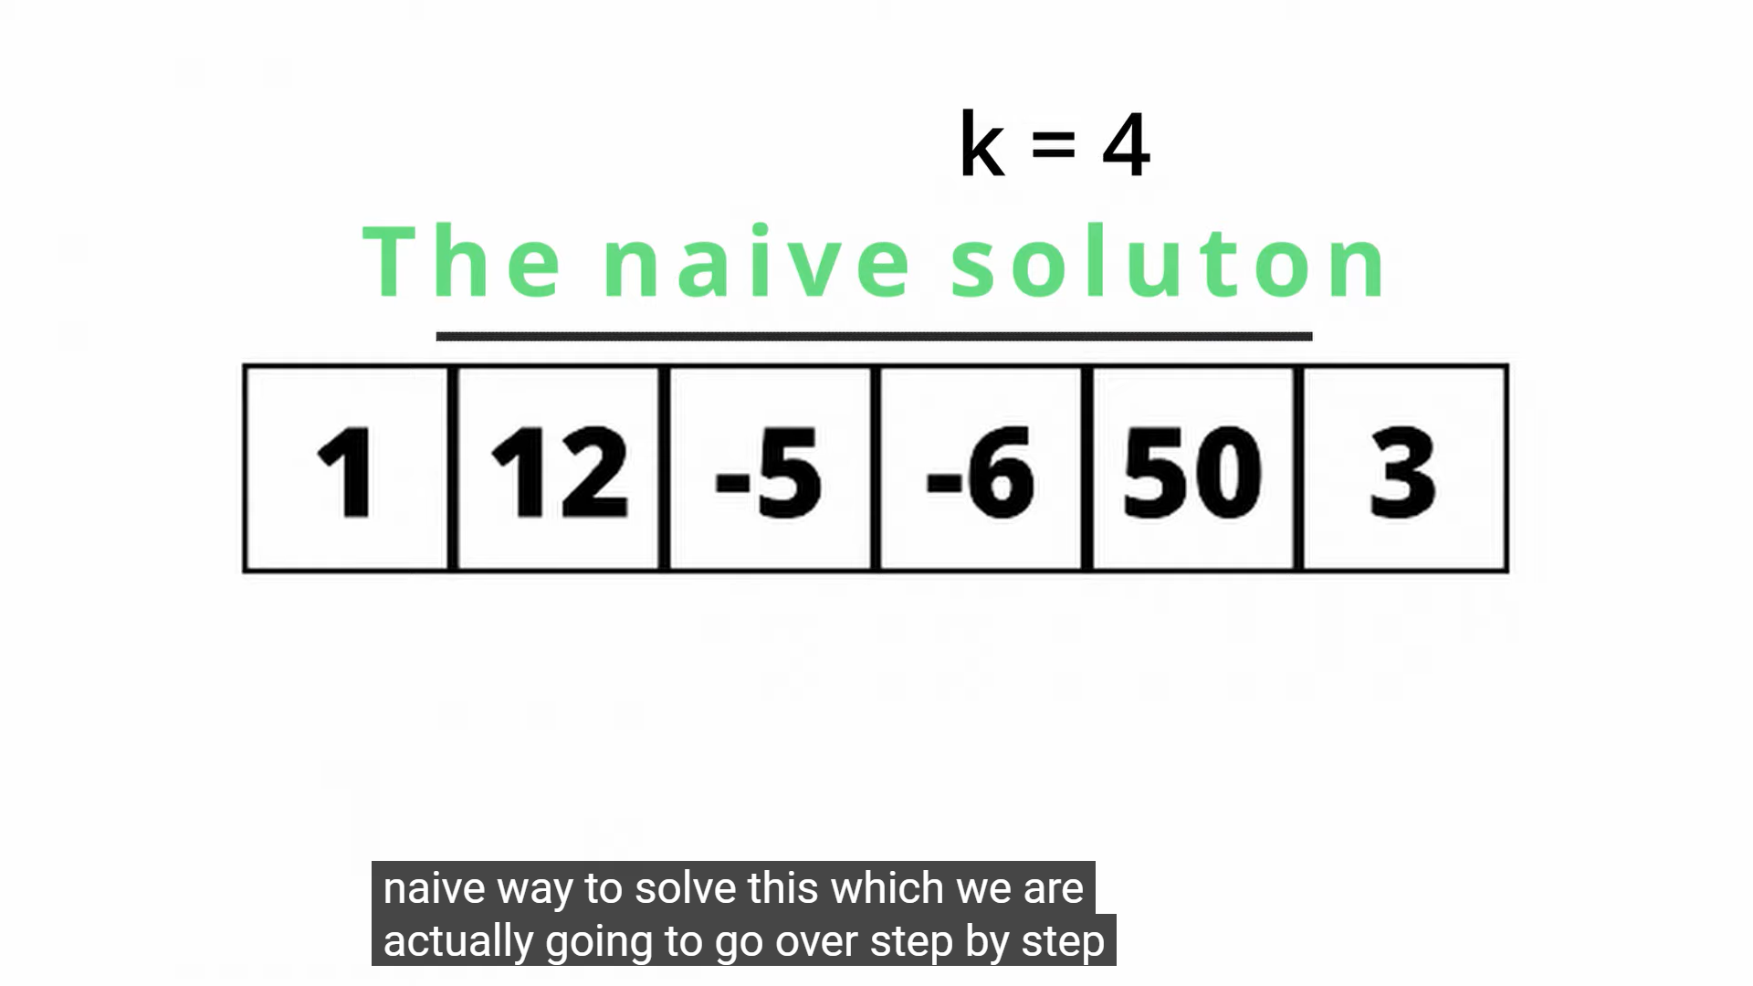

Slide 11
Non Window Sliding operation

Slide 12
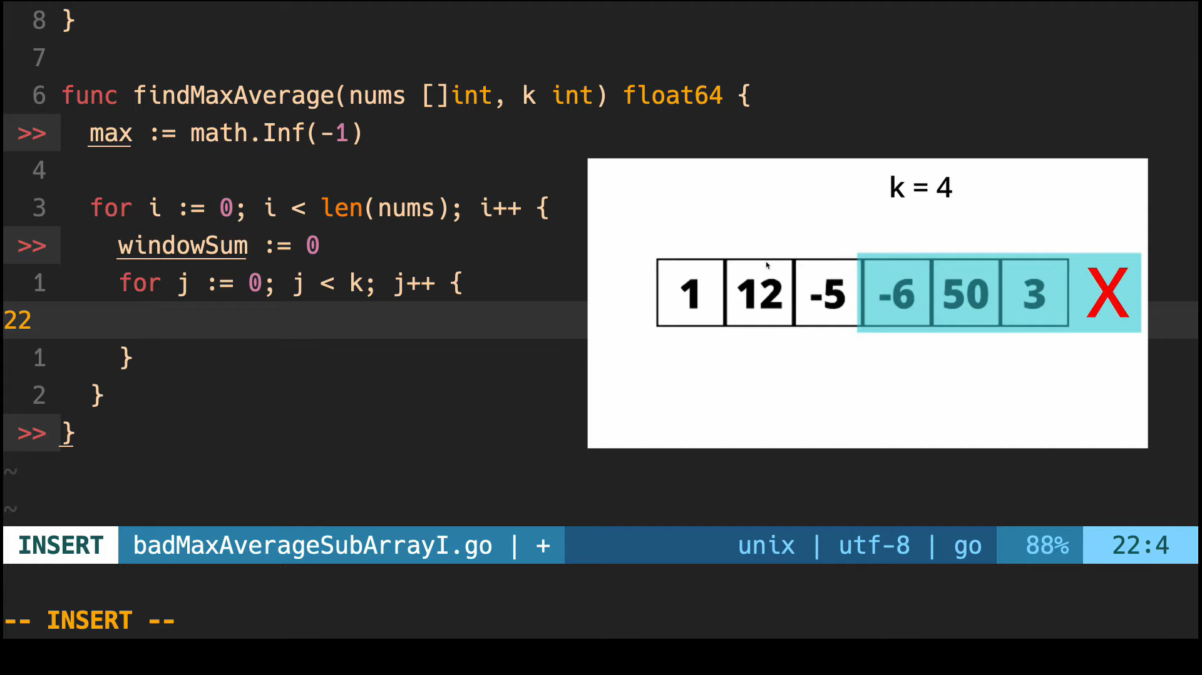

Slide 13
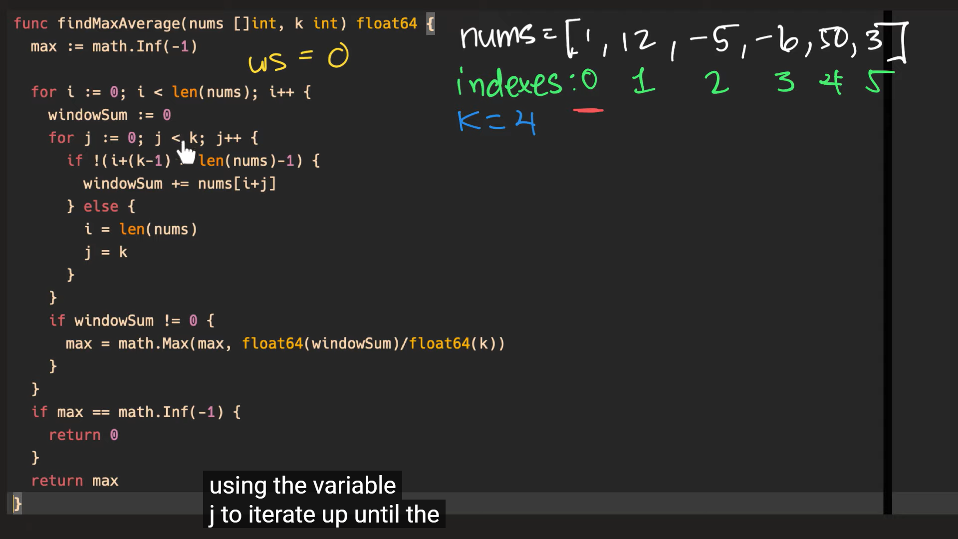

Slide 14
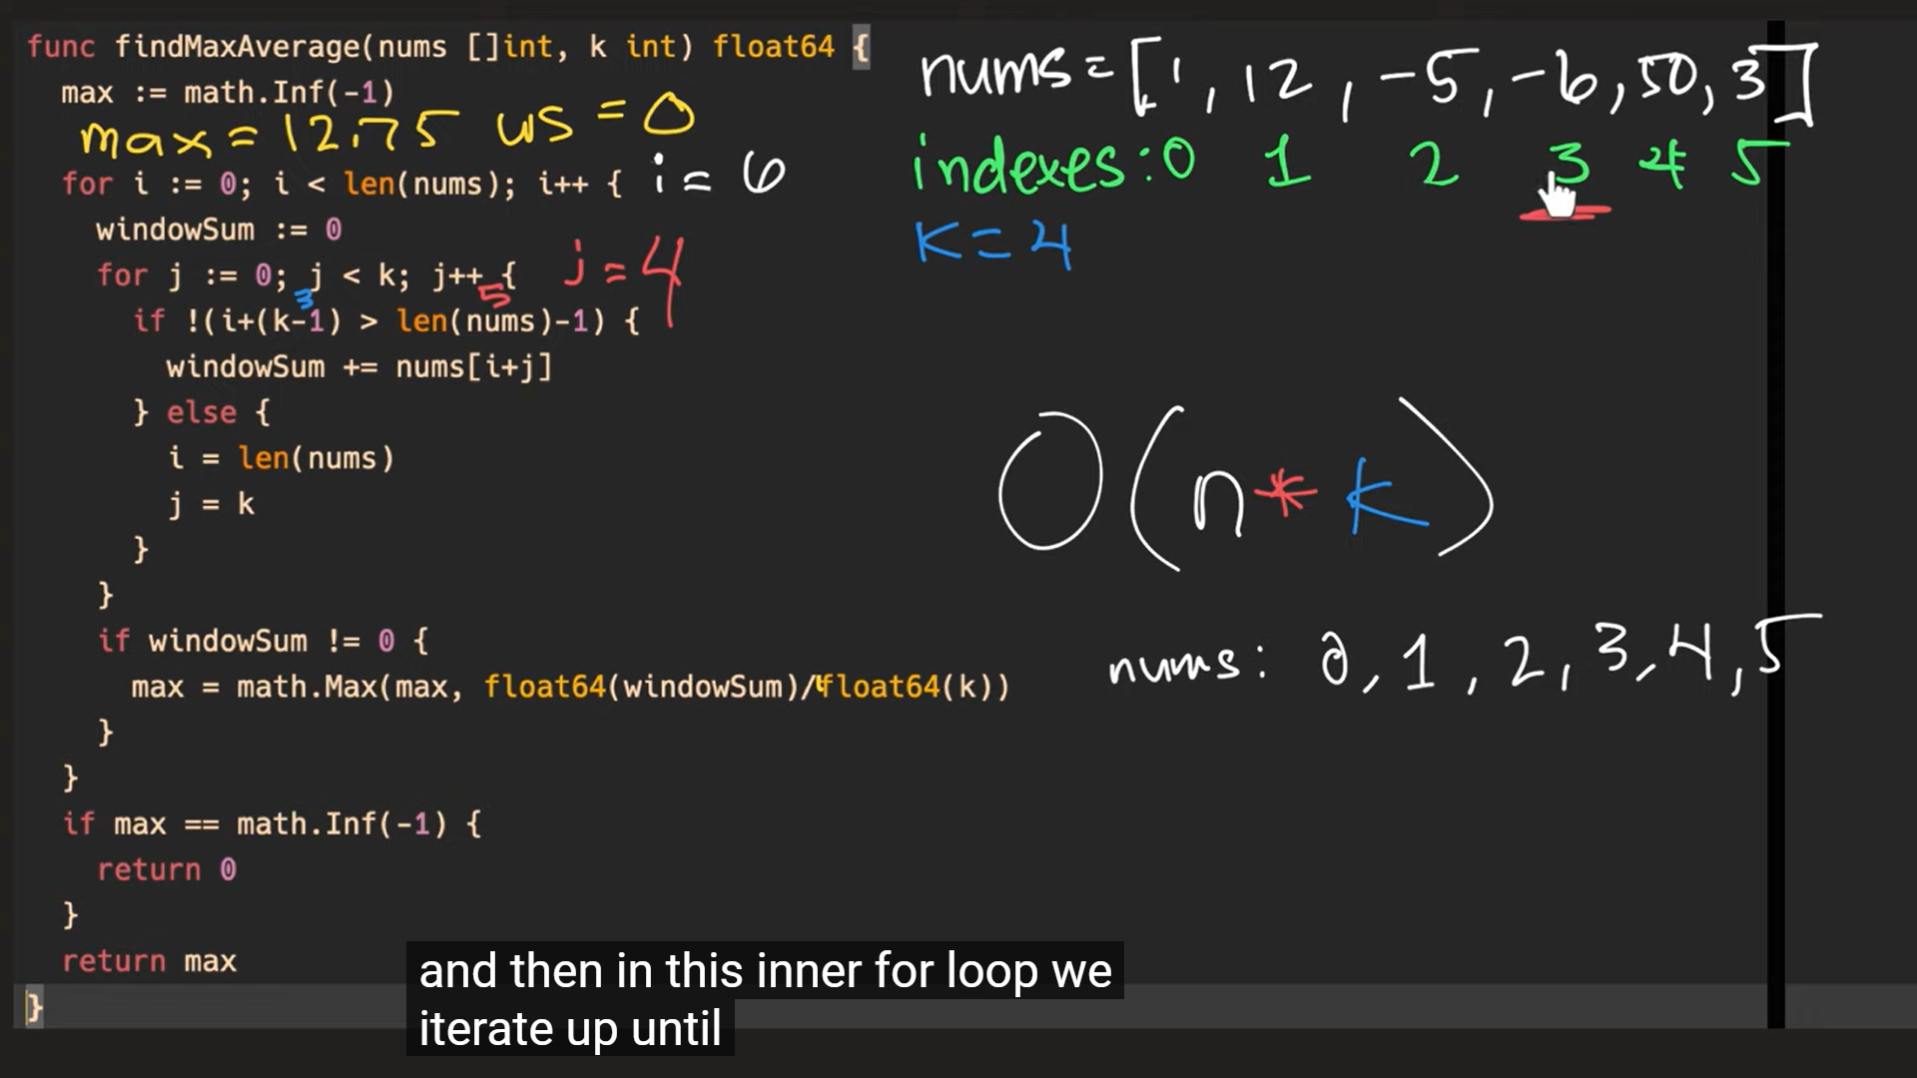

Slide 15
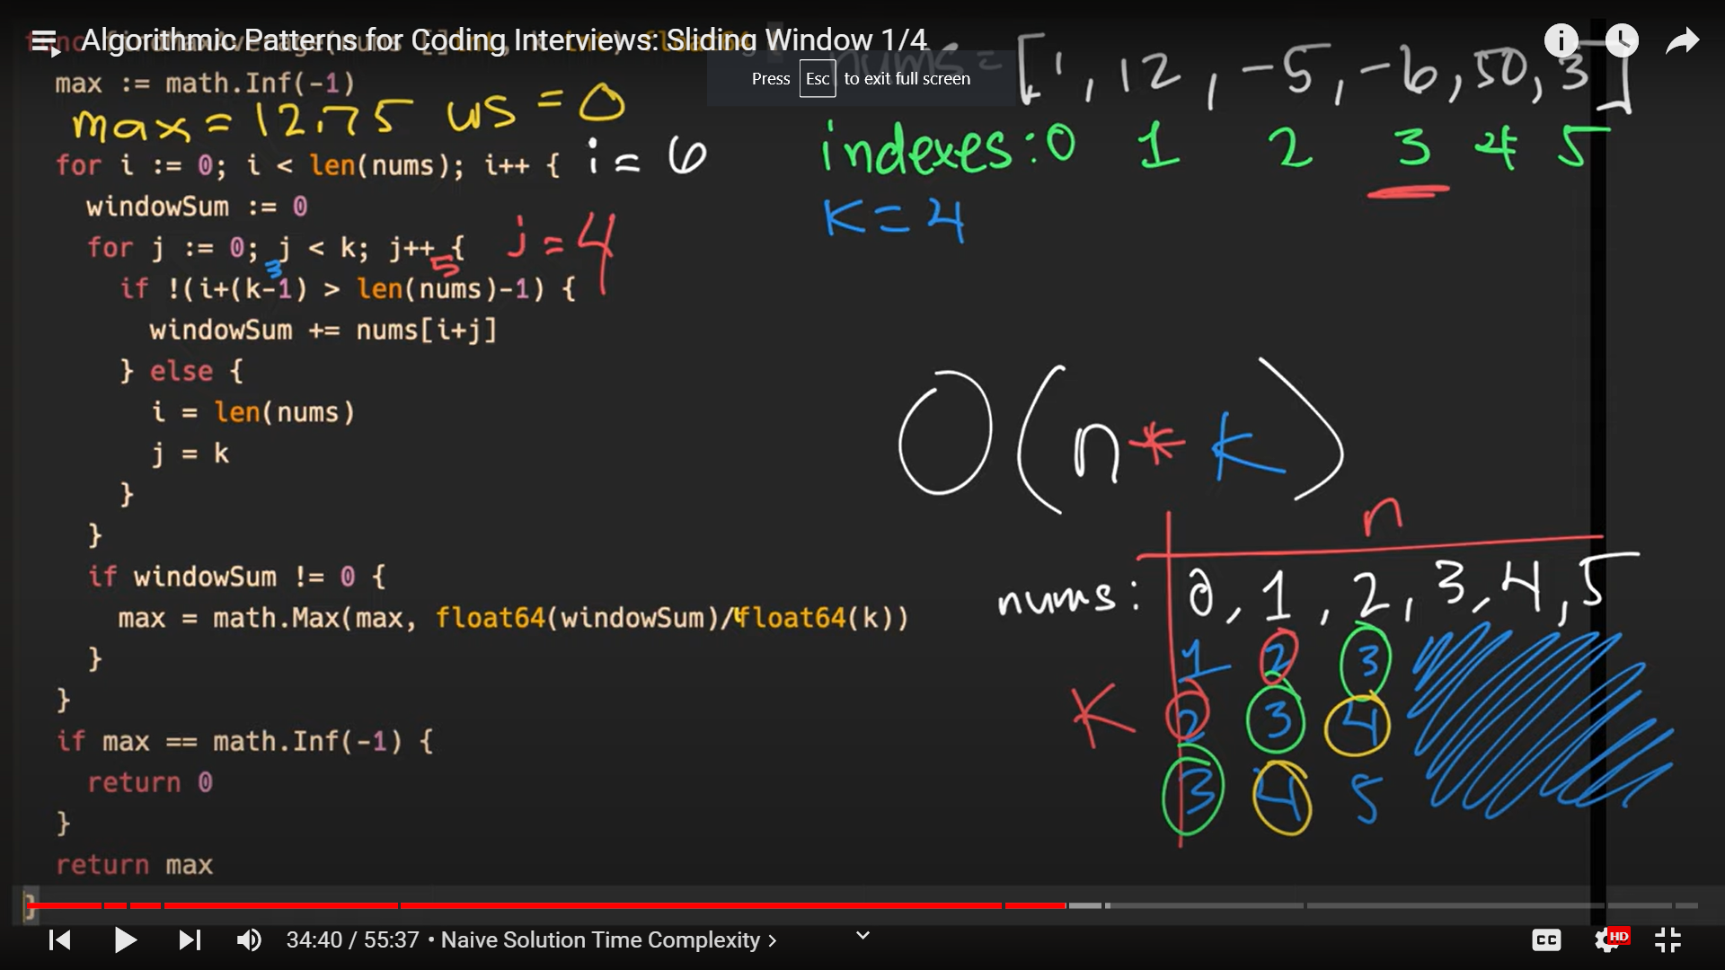

Slide 16
Window Sliding operation
On fixed

Slide 17
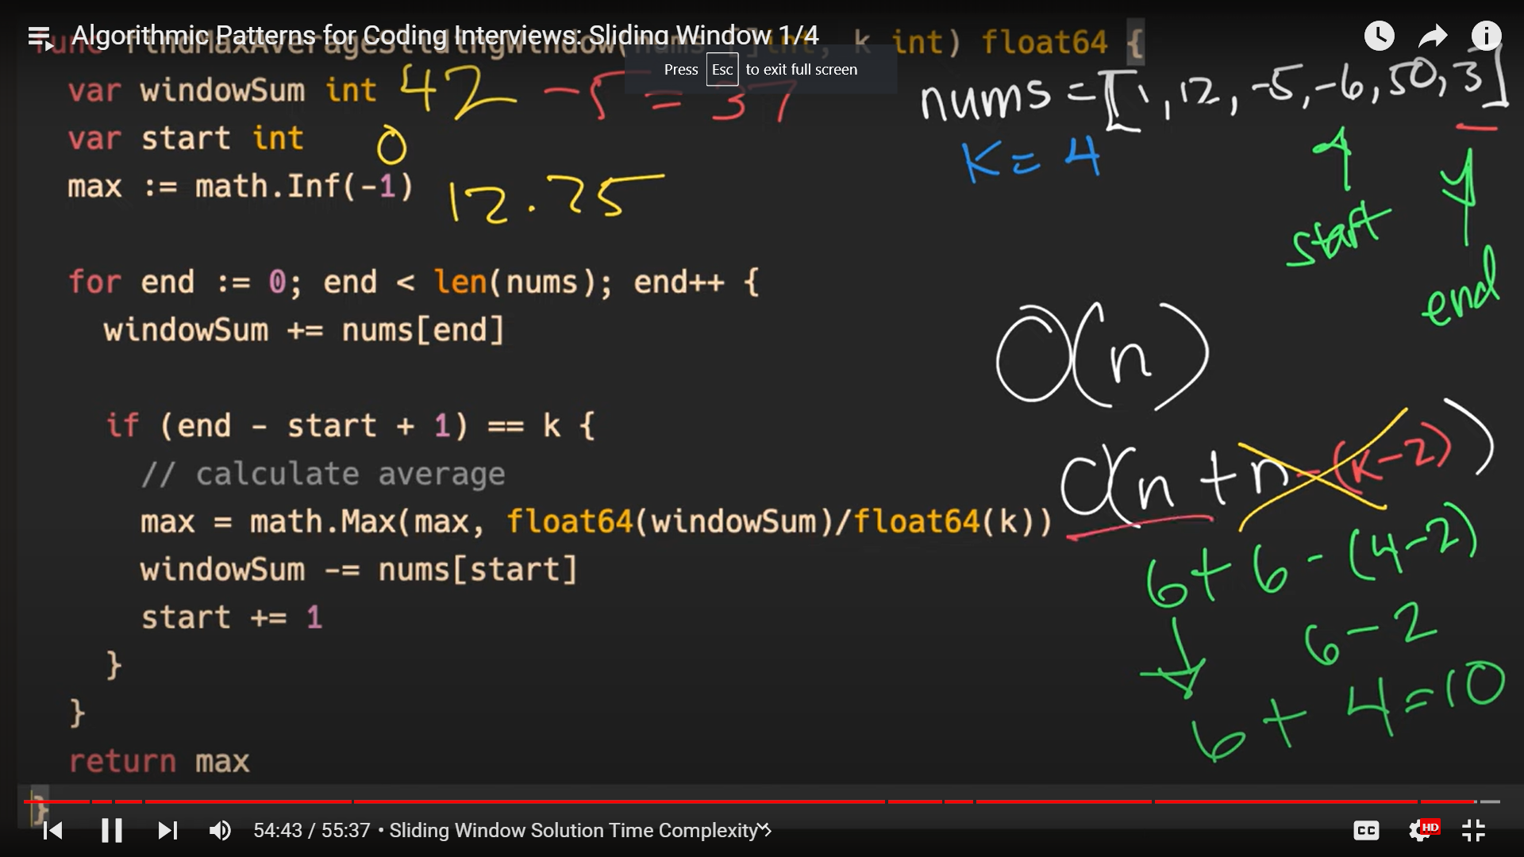

Slide 18
Window Sliding operation
ON dynamic

Slide 19
